Slide 1
PSDS Capstone: Data Analysis of Meteorite Impacts
Matthew W. Younce
August 10, 2021

Slide 2
Agenda
About me
Background on Meteorites
What does this have to do with NGA?
Data Used
Analysis and Results
For the future…

Slide 3
About Me
Matthew W. Younce
Hybrid Geospatial/Imagery Analyst
SGA and GA Team Lead, Time-Dominant Operations Center (AOWE)
14 years at NGA
Education: BS Earth Sciences, MS Science Education, MS Geology
Project Mentor: John Gutraj, SGO for Time-Dominant Operations

Slide 4

Background: Meteorites
Meteoroids - Object in space smaller than an asteroid
Meteor - flash of light in the sky as a meteoroid enters the Earth’s atmosphere - aka a “shooting star”
Meteorite - solid piece of a meteoroid, asteroid, comet, etc. that survives the fall through the atmosphere and impacts Earth
Barringer Crater in Arizona is the result of an impact 50,000 years ago, and is 1.2 kilometers in diameter.
Barringer Meteor Crater, Arizona
Canyon Diablo Meteorite

Slide 5
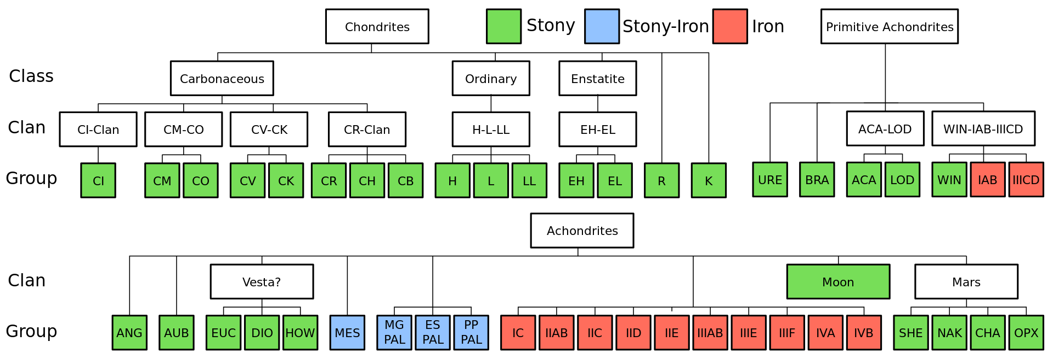
Background: Meteorites
Meteorites are identified based on various characteristics:
Type: Stony, Iron, Stony-Iron
Chondrules: Round grain structures formed when rock solidified in absence of gravity
Chondrites - have chondrules - from early solar system
Achondrite - doesn’t have chondrules - likely came from a planet or moon
Multiple classifications exist. One example:

Slide 6
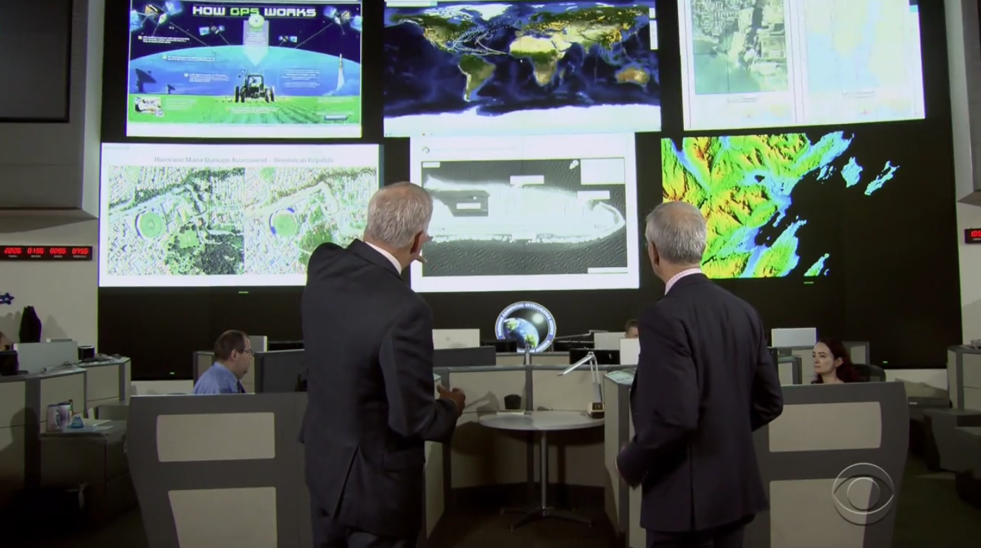
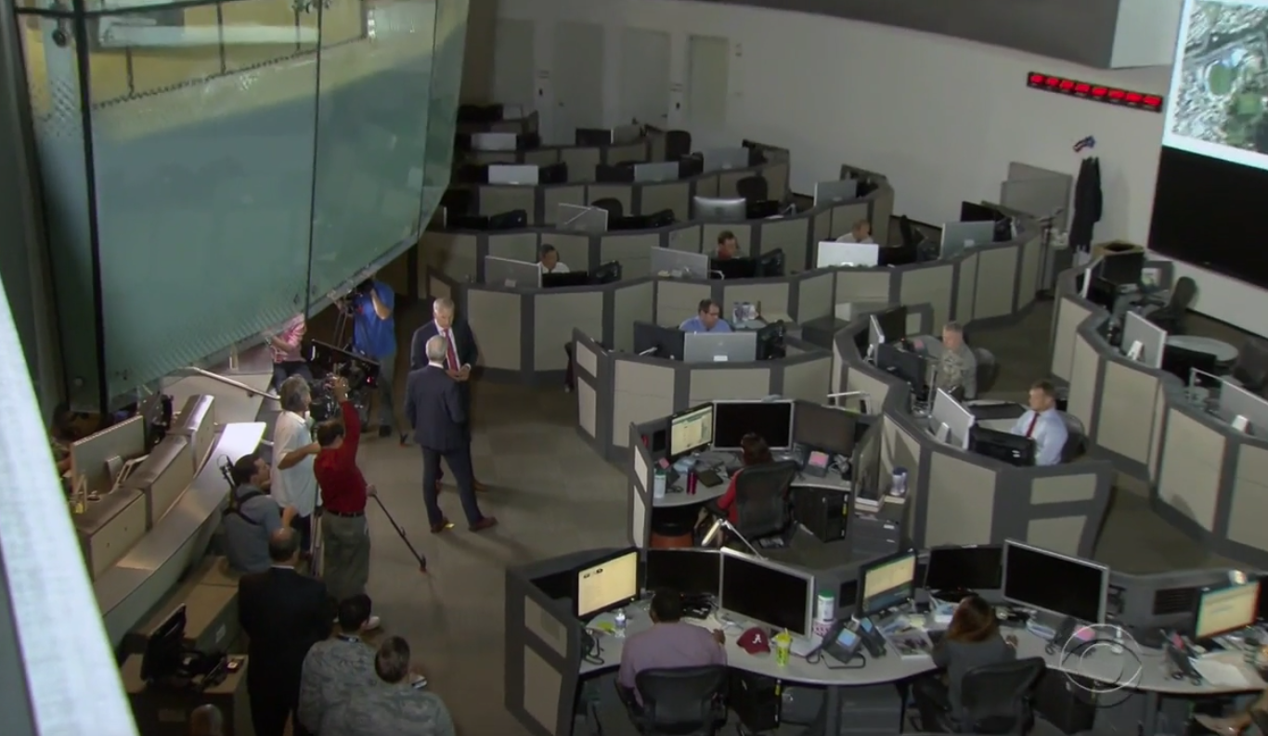
Opportunity for Data Science
I am an analyst at NGA/TDOC
Time-Dominant Operations Center
First phase analysis with a worldwide focus
Using data analysis and machine learning to predict meteorite impact timings or locations is very similar to predicting worldwide natural disasters or other events of interest.
While the parameters may not be the same, the overall technique should be similar.

Slide 7
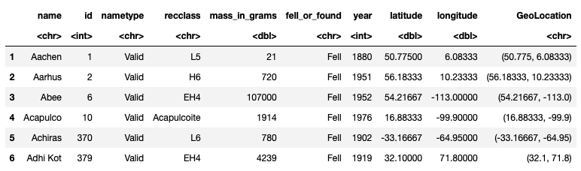
Data Details: Meteorites
Began with a single dataset of 34,513 known meteorites:

Slide 8
Data Details: Meteorites

Slide 9
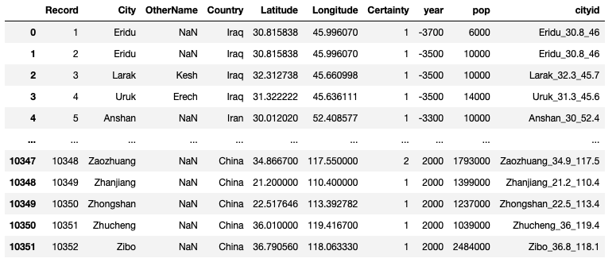
Data Details: Additional Datasets
Raster land cover datasets for 1700 - 1990
0.5° pixel size
Urban areas from 3700 BC - AD 2000

Slide 10
Analysis and Results
Went into the analysis with five questions:
Do meteorites fall at random or are there patterns to their impact locations?
Either as a whole, by class of meteorite, or some other parameter?
Are the numbers of meteorite falls consistent over history or are they changing?
Is there any connection to population?
Are there more falls recorded because more people to see it and more finds because people are in the area?
Are there trends between meteorites that have been observed hitting the ground and ones that are found?
Can predictions be made about future meteorite impacts by studying past impact events?

Slide 11
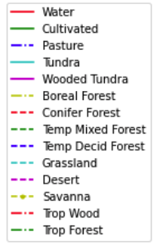
Analysis and Results
This is a graph showing the probability density of meteorites’ mass vs. the land cover where they were found/fell.
Savanna, Temperate Mixed Forest and Grasslands were more likely to have more massive meteorites
Tropical woodlands were most likely to have less massive meteorites

Slide 12
Analysis and Results
Meteorite falls over history …

Slide 13
Analysis and Results
Meteorite falls over history … look suspiciously like population growth.

Slide 14
Analysis and Results
Significant correlation between population and number of falls observed.
Normalizing falls per 1 million people: Since the late 1700s, the number of meteorites observed falling has increased significantly, even when population growth is taken into account.

Slide 15
Analysis and Results
Do falls and finds happen in the same place? No.
 | # of 1° grid squares
Falls only | 712
Falls and finds | 181
Finds only | 1063

Slide 16
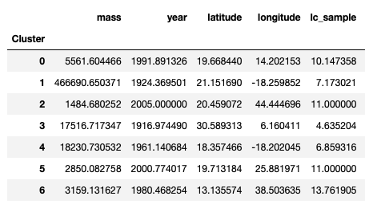
Analysis and Results
K-modes clustering
like K-means, but for categorical data.
Grouped into 7 clusters

Slide 17
For the Future
Additional analyses that were not run:
Ultimately, I found that while some trends are visible, meteorite impacts are pretty random, with the data at hand.
With information on orbit shape and meteoroid velocity, more precise predictions can be made.
Similarly, for my work in the TDOC, while a record of past events will give a clue to future events, much more data is needed.

